Slide 1
Introduction to SparkSQL

Slide 2
What is SparkSQL?
Spark SQL is Apache Spark's module for working with structured data.
Spark
Streaming
SparkSQL
GraphX
MLlib
Spark

Slide 3
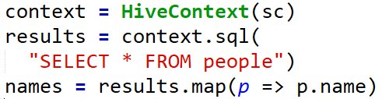
Seamlessly mix SQL queries with Spark Programs
Spark SQL lets you query structured data inside Spark programs, using either SQL or a familiar DataFrame API. Usable in Java, Scala, Python and R.
The above shows applying a function to the results of SQL queries

Slide 4
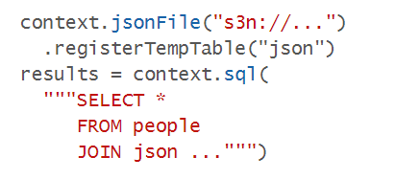
Uniform Data Access
Connect to any data source the same way.
DataFrames and SQL provide a common way to access a variety of data sources, including Hive, Avro, Parquet, ORC, JSON, and JDBC. You can even join data across these sources.
Query and join different data sources

Slide 5
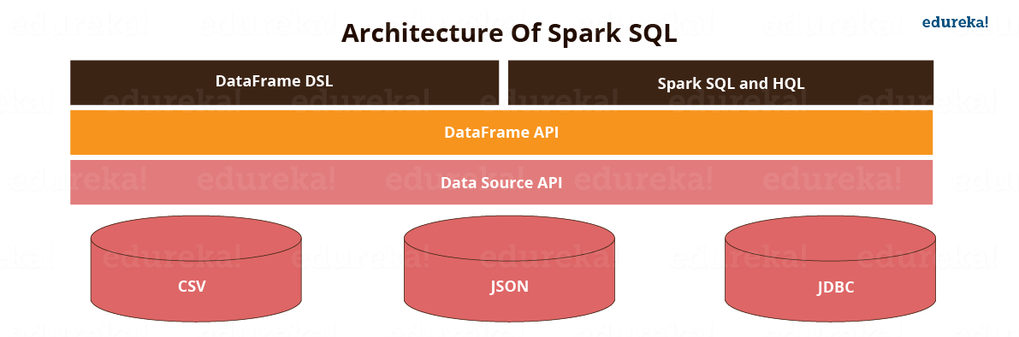
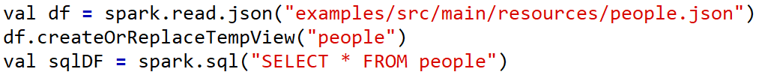
The Data Source API allows SparkSQL to read and write to data in a wide variety of data formats.
People can query database via the DataFrames API using either DataFrame DSL (domain-specific language) or Spark SQL and HQL
DataFrame DSL example
Spark SQL syntax

Slide 6
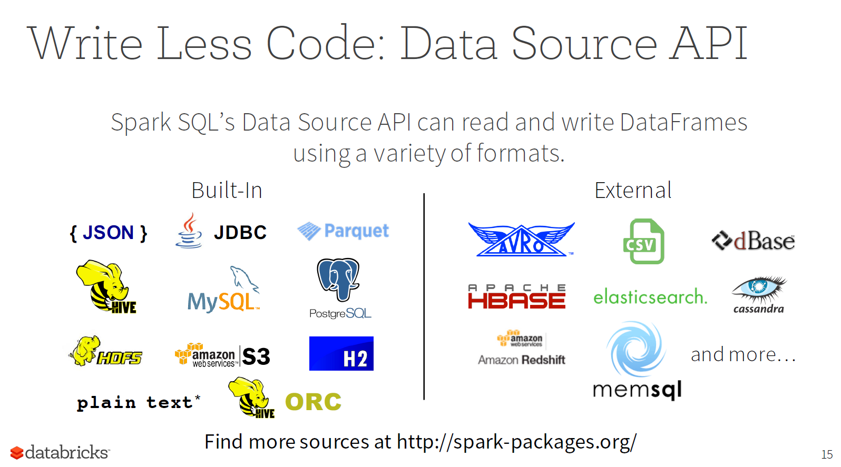

Slide 7
